Slide 1




prioritizr Systematic conservation planning in R R
Richard Schuster & Jeffrey Hanson
jeffrey.hanson@uqconnect.edu.au
prioritizr.net

Slide 2
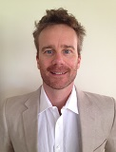
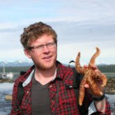
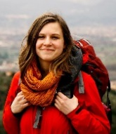
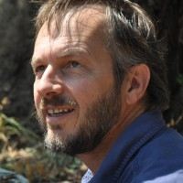
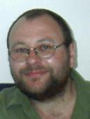
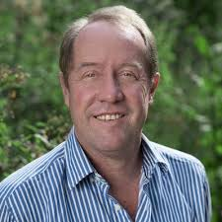
Acknowledgements
Matt Strimas-Mackey
Nina Morrell
Matt Watts
Joe Bennett
Peter Arcese
Hugh Possingham

Slide 3
How should $we
$manage $areas to
$achieve
$conservation?

Slide 4



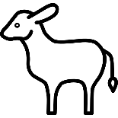


Slide 5
Objective
Maximize number
of populations
in reserves,
subject to budget?

Slide 6
Objective
Maximize number
of threatened
populations in
reserves,
subject to budget?

Slide 7
Objective
Maximize
phylogenetic
diversity in reserves,
subject to budget?

Slide 8
Objective
Minimize cost,
subject to targets to
ensure adequate
representation
in reserves?

Slide 9
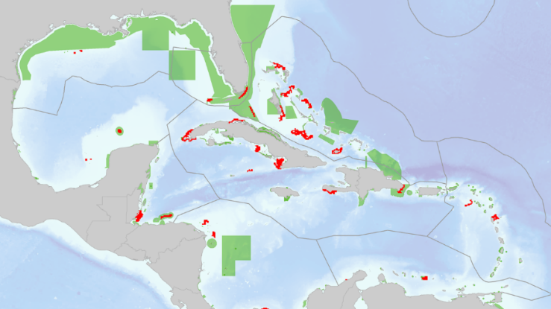
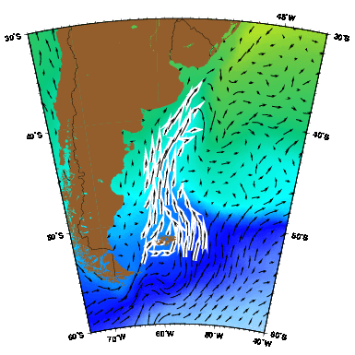
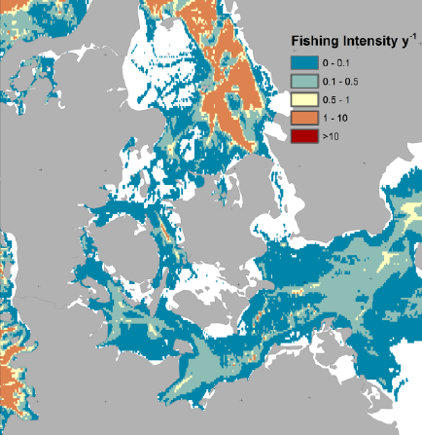
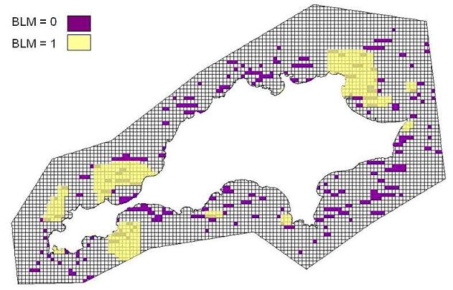
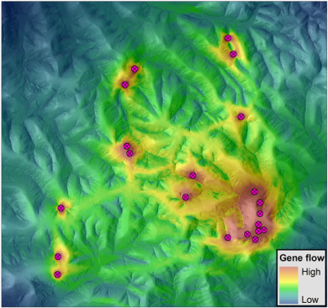
Constraints and Penalties

Slide 10
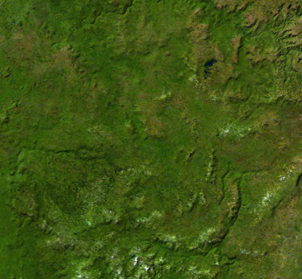
Decision type
Protect or not?
Different amounts?
Multiple actions?

Slide 11





Solver
?
?
?
?

Slide 12

prioritizr
Design your problem
Find optimal solutions
Ideally, fast!

Slide 13
Design your problem
Mental model
problem <- data +
objective +
constraints +
penalties +
decision type +
solver
solution <- solve(problem)

Slide 14
Design your problem
Mental model
Code
problem <- data +
objective +
constraints +
penalties +
decision type +
solver
solution <- solve(problem)
p <- problem(pu’s, feat’s) %>%
add_min_set_objective() %>%
add_relative_targets(….) %>%
add_boundary_penalties(….) %>%
add_binary_decisions() %>%
add_rsymphony_solver()
solution <- solve(p)

Slide 15
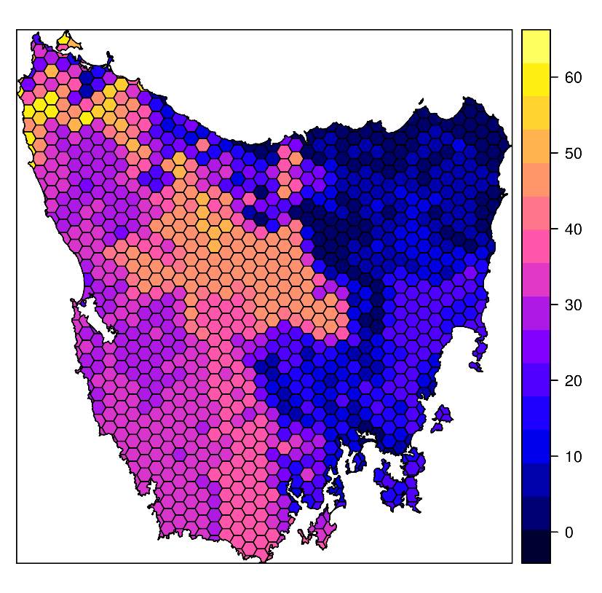
Design your problem
Study area: Tasmania, Australia
Planning units: 1130 hexagons
Features: 63 vegetation types

Slide 16
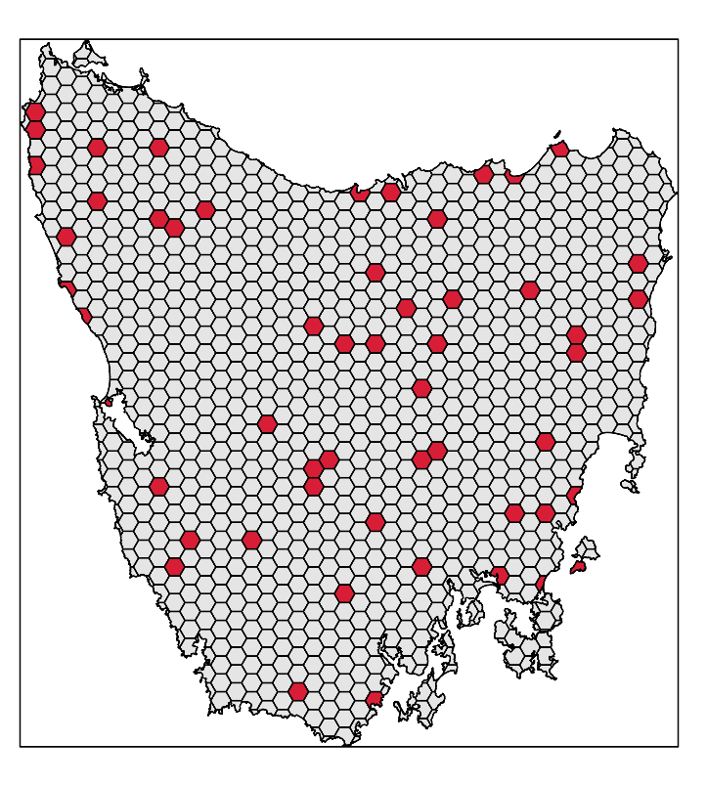
Design your problem
problem(tas_pu, tas_features,
"cost") %>%
add_min_set_objective() %>%
add_relative_targets(0.1) %>% add_binary_decisions() %>%
add_gurobi_solver(gap = 0) %>% solve()

Slide 17
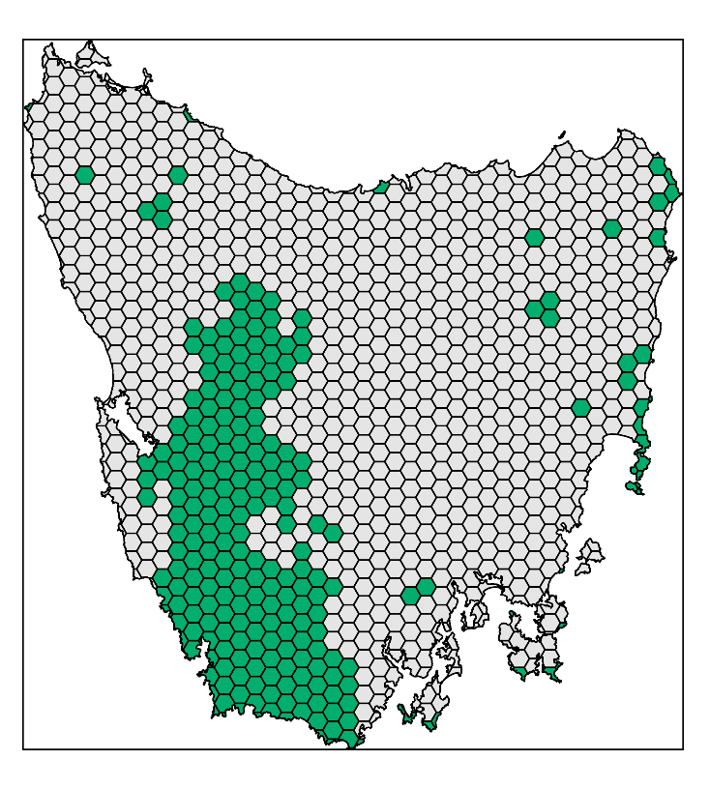
Design your problem
problem(tas_pu, tas_features,
"cost") %>%
add_min_set_objective() %>%
add_relative_targets(0.1) %>% add_locked_in_constraints("in") %>%
add_binary_decisions() %>%
add_gurobi_solver(gap = 0) %>% solve()

Slide 18
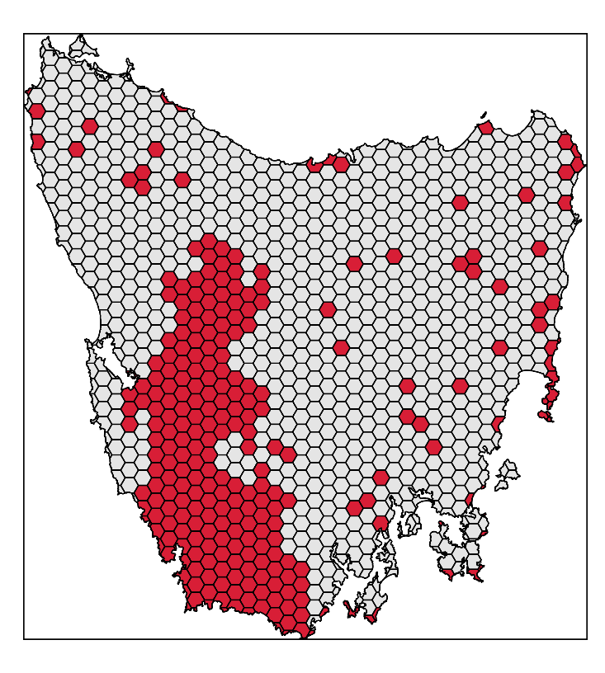
Design your problem
problem(tas_pu, tas_features,
"cost") %>%
add_min_set_objective() %>%
add_relative_targets(0.1) %>% add_locked_in_constraints("in") %>%
add_binary_decisions() %>%
add_gurobi_solver(gap = 0) %>% solve()

Slide 19
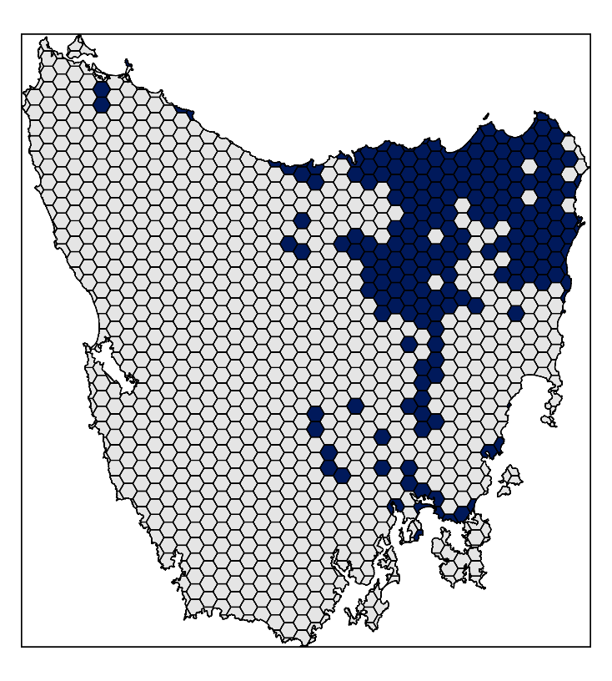
Design your problem
problem(tas_pu, tas_features,
"cost") %>%
add_min_set_objective() %>%
add_relative_targets(0.1) %>% add_locked_in_constraints("in") %>%
add_locked_out_constraints("out") %>%
add_binary_decisions() %>%
add_gurobi_solver(gap = 0) %>% solve()

Slide 20
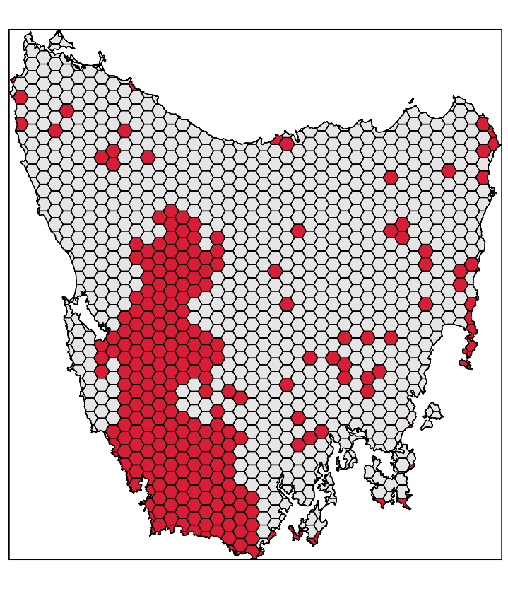
Design your problem
problem(tas_pu, tas_features,
"cost") %>%
add_min_set_objective() %>%
add_relative_targets(0.1) %>% add_locked_in_constraints("in") %>%
add_locked_out_constraints("out") %>%
add_binary_decisions() %>%
add_gurobi_solver(gap = 0) %>% solve()

Slide 21
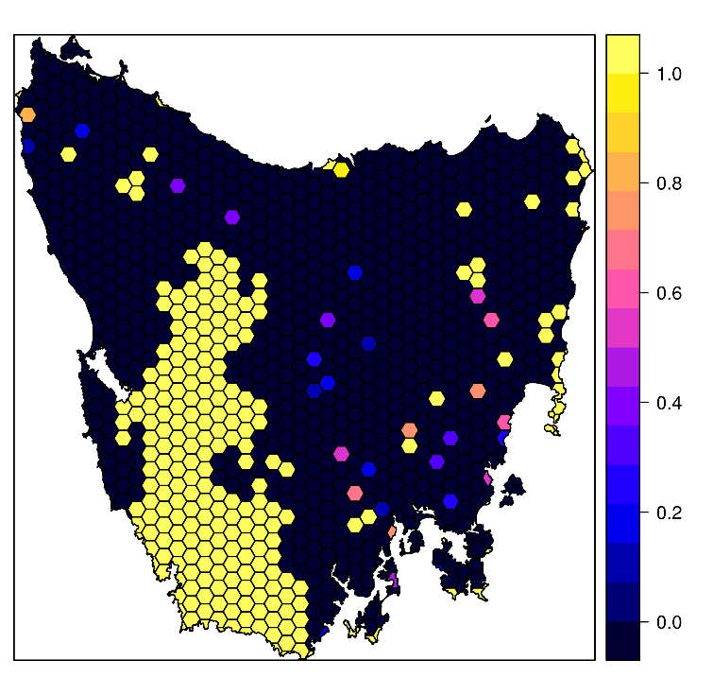
Design your problem
problem(tas_pu, tas_features,
"cost") %>%
add_min_set_objective() %>%
add_relative_targets(0.1) %>% add_locked_in_constraints("in") %>%
add_locked_out_constraints("out") %>%
add_proportion_decisions() %>%
add_gurobi_solver(gap = 0) %>% solve()

Slide 22
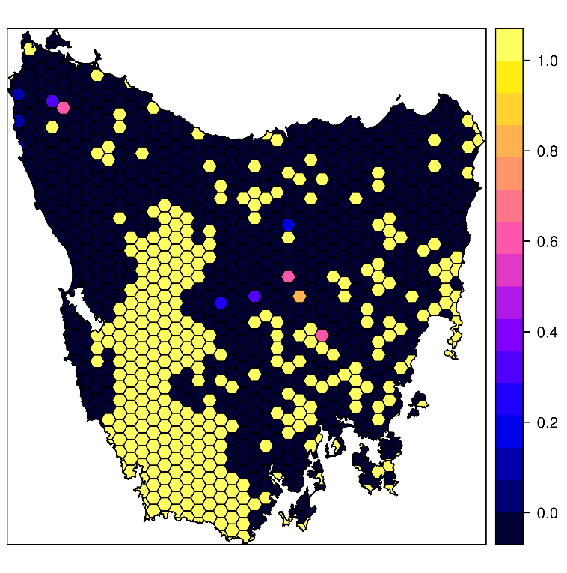
Design your problem
problem(tas_pu, tas_features,
"cost") %>%
add_max_features_objective(budget)%>%
add_relative_targets(0.1) %>% add_locked_in_constraints("in") %>%
add_locked_out_constraints("out") %>%
add_proportion_decisions() %>%
add_gurobi_solver(gap = 0) %>%
solve()

Slide 23
Design your problem
Objectives
add_max_features_objective
add_max_phylo_objective
add_max_utility_objective
add_min_set_objective
Penalties
add_connectivity_penalties
add_boundary_penalties
add_feature_weights
Decisions
add_bindary_decisions
add_proportion_decisions
add_semicontinuous_decisions
Constraints
add_feature_contiguity_constraints
add_contiguity_constraints
add_locked_in_constraints
add_locked_out_constraints
add_neighbour_constraints
Solvers
add_gurobi_solver
add_lpysmphony_solver
add_rsymphony_solver

Slide 24
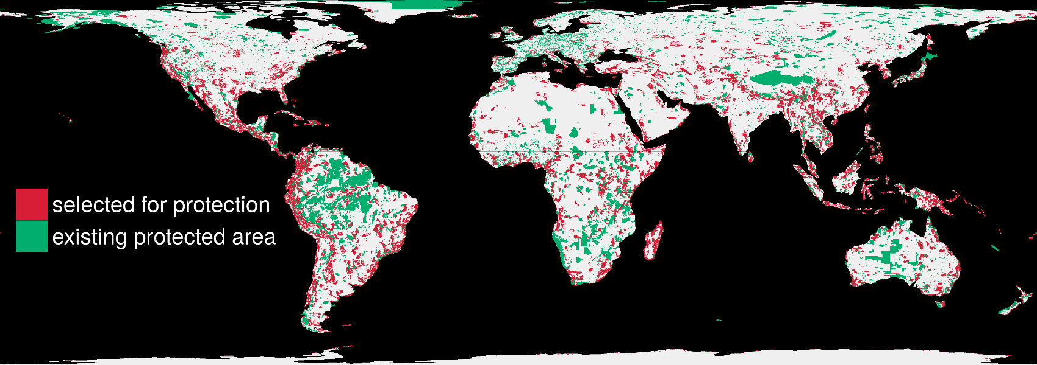
Find optimal solutions, ideally fast
1.5 million planning units + 22,644 species: 76 minutes

Slide 25
Insert Richard’s slides here

Slide 26
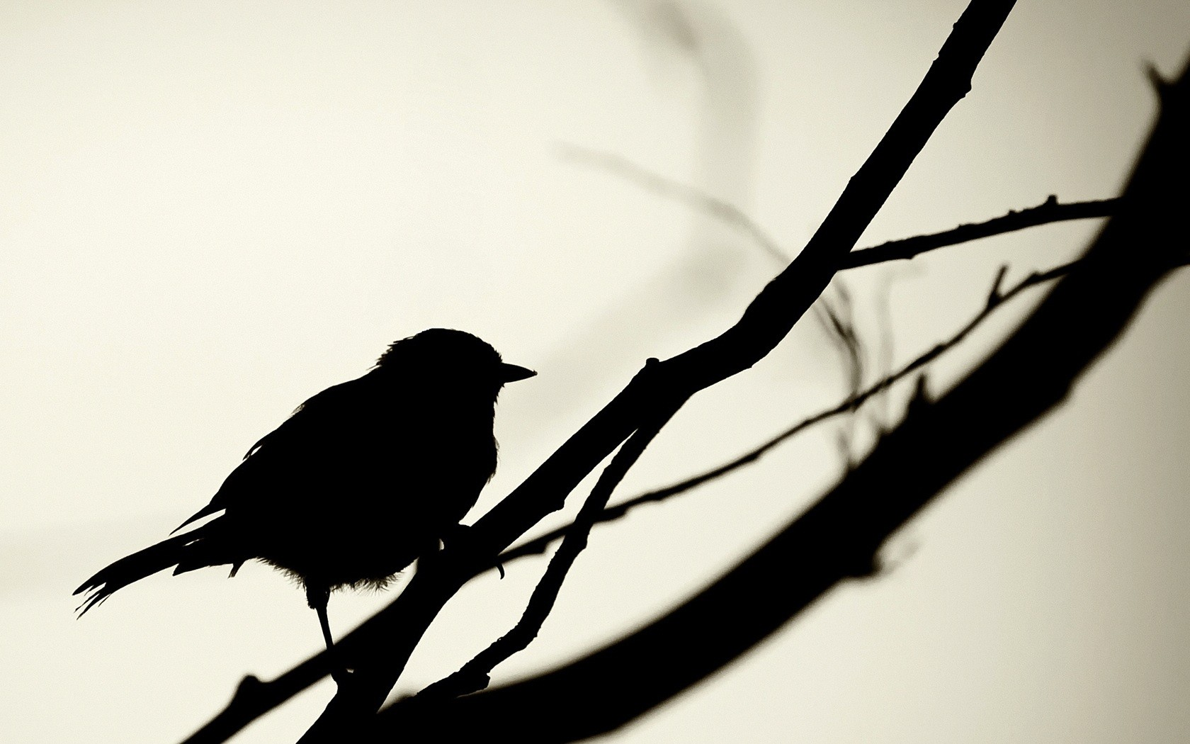

richard.schuster@glel.carleton.ca
jeffrey.hanson@uqconnect.edu.au
prioritizr.net

